Slide 1
Need for Profiling

Slide 2
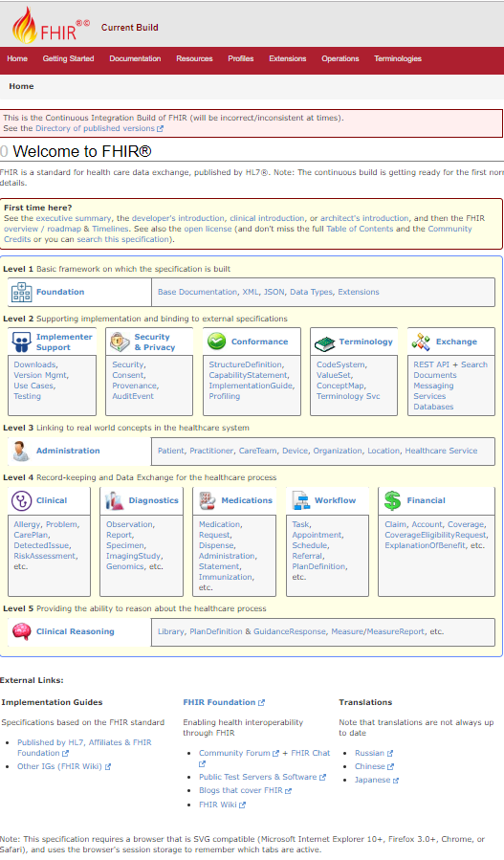
FHIR == magic?
FHIR is a standard for interoperability
Therefore: If two systems both comply with FHIR, they will fully interoperate
True or false?
Why?

Slide 3
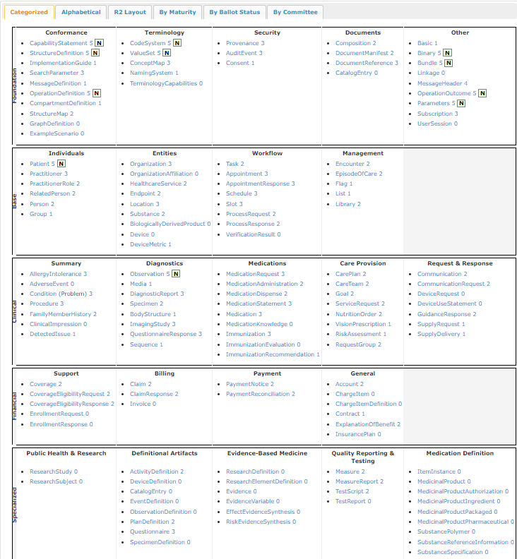
FHIR Resources
140+ resources
How many real systems will support all of these:
CarePlan, SubstancePolymer, PaymentReconciliation, CompartmentDefinition

Slide 4
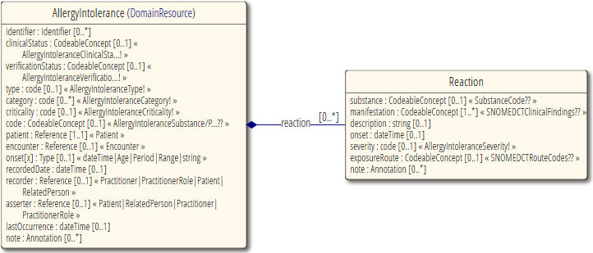
Interoperability - Elements
Most elements are optional
All data type components are optional
Most terminologies are unconstrained

Slide 5
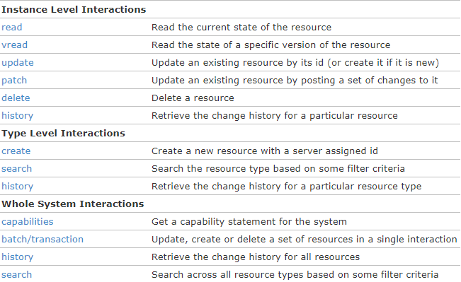
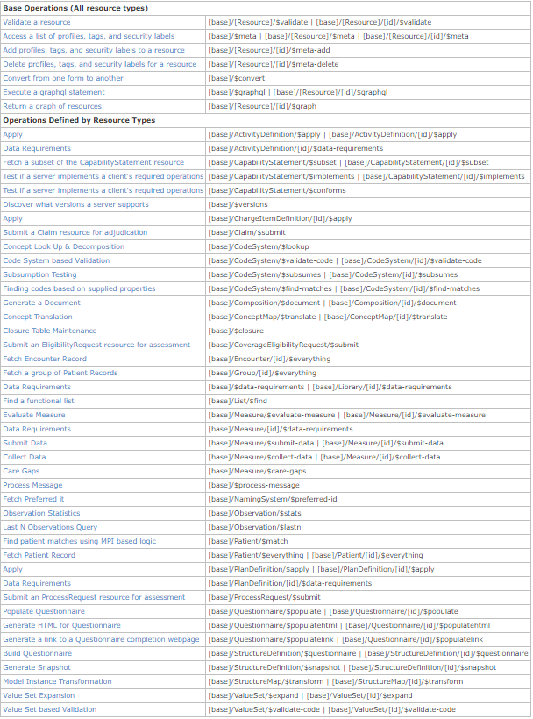
Operations & behavior
Plus there are custom operations, documents, messages, etc.

Slide 6
The need for profiling
Many different contexts in healthcare, but a single set of Resources
FHIR provides a “platform specification”
Standard building blocks for interoperability solutions
Requires further adaptation to the context of use

Slide 7
The need for profiling
Need to be able to describe adaptations based on use and context
What resources and elements are used?
What API features are used?
What terminologies are used?
How do these map to local requirements/implementations?

Slide 8
The need for profiles
Allow for these usage statements to be:
Authored in a structured manner
Published in a repository
Used as the basis for validation, reporting, and code generation.

Slide 9
Profile-less FHIR
You don’t need profiles to interoperate with FHIR
Resources are “discrete” enough that the mechanism to populate most elements is clear
Approach
Populate/consume all elements you know, use HL7 or country-standard extensions for extras
Map to/from “recommended” terminologies as much as possible, populate CodeableConcept.text
Expose capabilities in CapabilityStatement resource
Notes:
With profile, they can interoperate ‘ok’.

Slide 10
Profiling Overview And General PrinciPlEs
Notes:
Time start-10:00 (10 minutes)

Slide 11
FHIR “Profile”
A set of constraints on a FHIR resource
A set of constraints on another FHIR profile
But may also refer to:
An implementation guide
A conformance package

Slide 12

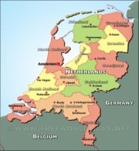

Who publishes?
http://www.hl7.org/fhir/StructureDefinition/iso-21090
http://www.hl7.nl/fhir/StructureDefinition/patient-nl
http://www.health4all.org/fhir/StructureDefinition/
Notes:
“Drive-by” or “bottom-up” operability: “Communicate first, standardize later”
First, business partners. Then, collaborations, communities. Maybe, finally, nation-wide
It’s a natural process that people will want to make it work first, then only coordinate what they really need to, and then realize they can broaden their approach to a community.
“Support”, of course top-down should still be possible! Maybe even a combi in the long-term

Slide 13
Layered profiles
More specific
Core
National
Organizational
Regional
All instances
National instances
Organizational instances
Regional instances
More generic
Conform to
Conform to
Conform to
Conform to
Volume
Volume

Slide 14
Conformance Resources
Terminology
ValueSet
ConceptMap
Content
StructureDefinition
Operations
OperationDefinition
SearchParameter
Misc.
CapabilityStatement
TestScript
Compartment Definition
Implementation Guide
CodingSystem
GraphDefinition
ExampleScenario
StructureMap
MessageDefinition
NamingSystem

Slide 15
Terminology
Define mappings between terms from different systems
ConceptMap
Set of codes for a particular use
ValueSet
CodeSystem
Define a set of concepts and their codes
NamingSystem
Define identifier and coding “systems”

Slide 16
Content
StructureDefinition
Define resources & data types
Define constraints & extensions
StructureMap
Syntax independent transformation of FHIR & non-FHIR instances
GraphDefinition
Defines collection of inter-related resources for query, update, etc.
Notes:
http://Hl7.org/fhir/conformance-module.html#roadmap
“The exact role of "Data Element Definitions" is still being studied”

Slide 17
Operations
Define additional (custom) operations
SearchParameter
Define additional (custom) searches
OperationDefinition
Compartment Definition
Define access to (related) resources
MessageDefinition
Define message events, content & allowed responses

Slide 18
Miscellaneous
CapabilityStatement
Define set of compliance tests against a FHIR server and/or client
Define how to use FHIR in a specific use case
TestScript
Define (actual or required) server capabilities
ImplementationGuide
ExampleScenario
Walks through a workflow showing how resources work together

Slide 19
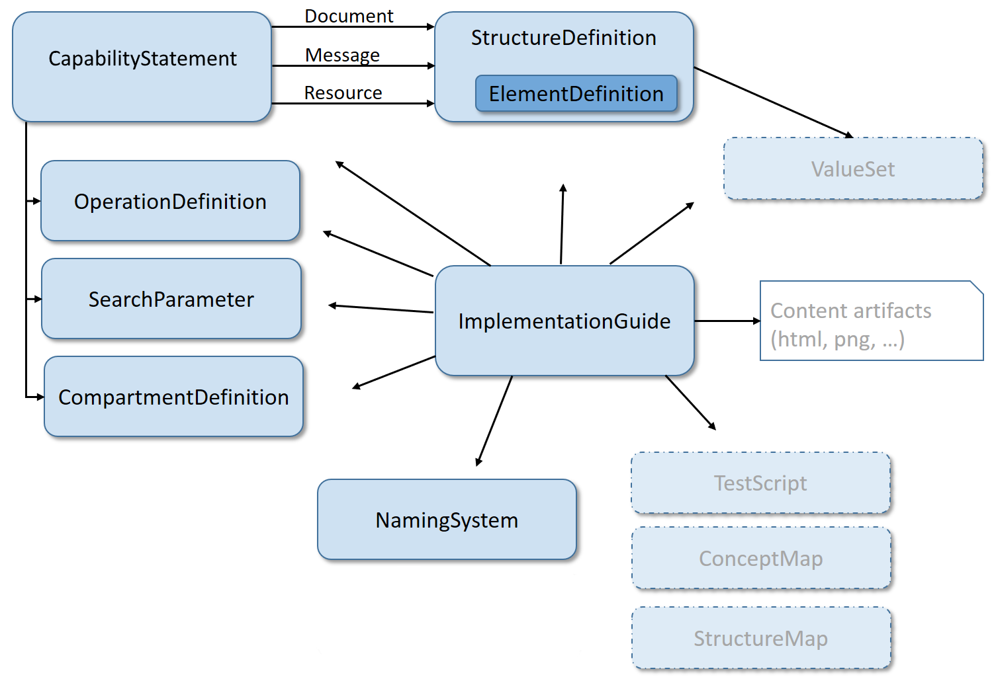
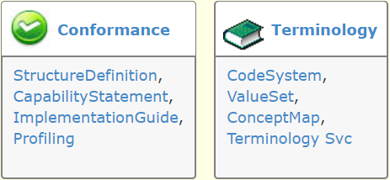
Modules

Slide 20
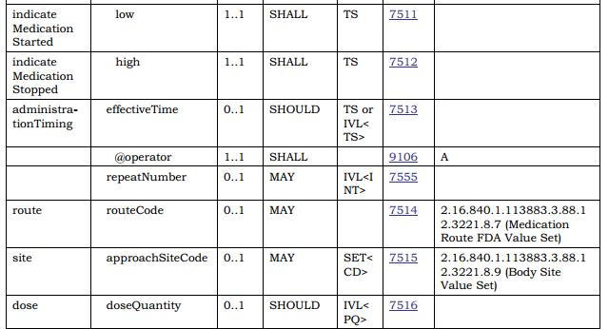
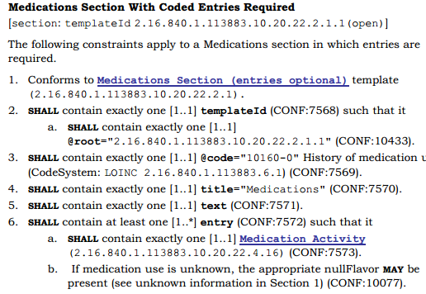
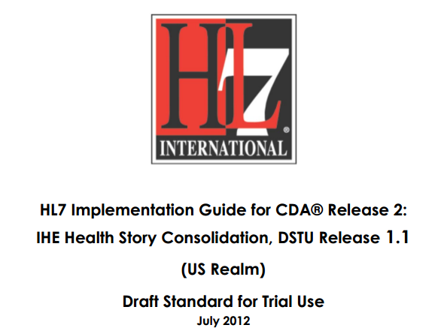
In v3 CDA…”text-based”

Slide 21
Conformance Resources
In FHIR, all conformance resources are in computable form
Share in a registry
Query to find relevant resources
At design time or at runtime
Subscribe to monitor changes
Compare with instances created by others and see where the mismatches are
How well will these systems interoperate?
Code generation

Slide 22
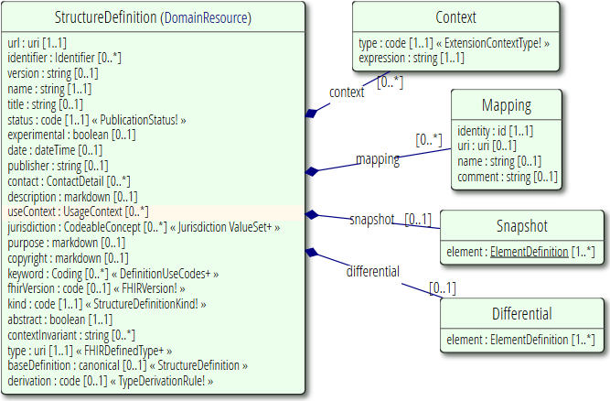







Publish!
Find & maintain
http://simplifier.net
http://registry.fhir.org
Retrieve & use
Notes:
A profile can be published on a FHIR (based) server (it’s a Resource, after all)
On Foundry: http://simplifier.net
Or in a version-management system, or by e-mail, or…
As long as people can *find* them, because publishing your profile should help others to find & adhere to it.

Slide 23
Profiling Terminology
Notes:
Time start-10:00 (10 minutes)

Slide 24
Profiling Terminology
Tighten the binding strength (e.g. Extensible -> Required)
Change the value set
required: Constrain allowed codes
e.g. male/female/other/unknown -> male/female
extensible: May constrain and add concepts not covered by existing codes
preferred, example: Can pick whatever codes you like
But should ideally be able to map to/from preferred codes
You can propose changes to code systems and value sets owned by others
Can define codes in your own code system
Notes:
Two aspects: whether you as a profile author can change the valueset and
Whether the user of your profile can provide codes from other valuesets in an instance
Fhir defines offical extensions for special binding constraints: elementdefinition-maxValueSet and elementdefinition-minValueSet
List: http://hl7-fhir.github.io/elementdefinition-extensions.html
http://hl7-fhir.github.io/extension-elementdefinition-minvalueset.html - The minimum allowable value set, for use when the binding strength is 'required' or 'extensible'.
http://hl7-fhir.github.io/extension-elementdefinition-maxvalueset.html - The maximum allowable value set, for use when the binding strength is 'extensible'.
Also see issue 9185: http://gforge.hl7.org/gf/project/fhir/tracker/?action=TrackerItemEdit&tracker_item_id=9195&start=0

Slide 25
ValueSet Tooling
Grahame
http://www.healthintersections.com.au/FhirServer
Apelon
http://www.apelon.com/
ClinFHIR.com
CodeSystem Builder
ValueSet Explorer
Snapper
http://ontoserver.csiro.au/snapper2-dev/

Slide 26
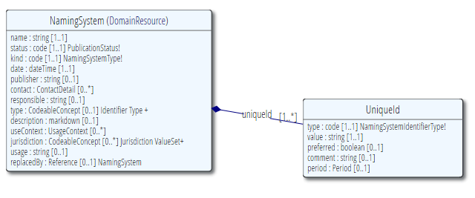
NamingSystem
What is the URL for a Michigan Podiatrist License Number?
A New South Wales Driver’s License Number?
When converting between FHIR and CDA, how to I find the OID for this URL (or vice versa)
Notes:
Known Code Systems
http://hl7.org/implement/standards/fhir/terminologies-systems.html
Example: http://hl7.org/implement/standards/fhir/namingsystem-registry.html
id: us-ssn
name: United States Social Security Number

Slide 27
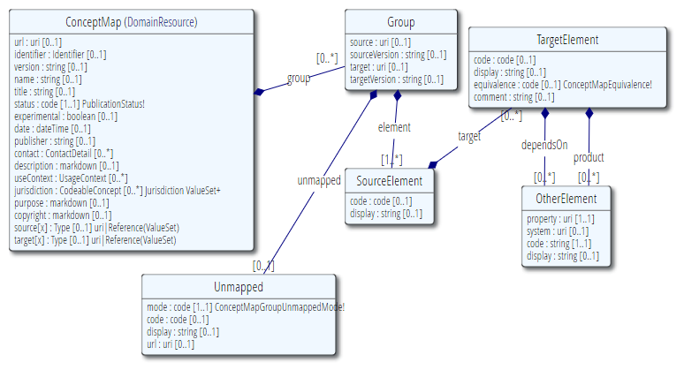
ConceptMap
Define mapping
From one set of concepts to one or more other concept(s)
Notes:
http://hl7.org/implement/standards/fhir/conceptmap-example-specimen-type.html
v2 table 0487 => SNOMED-CT

Slide 28
Profiling Structures

Slide 29
Profile Uses
Why profile structures?
Define content for documents and messages
Define extensions
Set interoperability expectations in a particular context
National standards, types of care, business patterns
Clinical practice guidelines / detailed clinical models
Document system capabilities

Slide 30
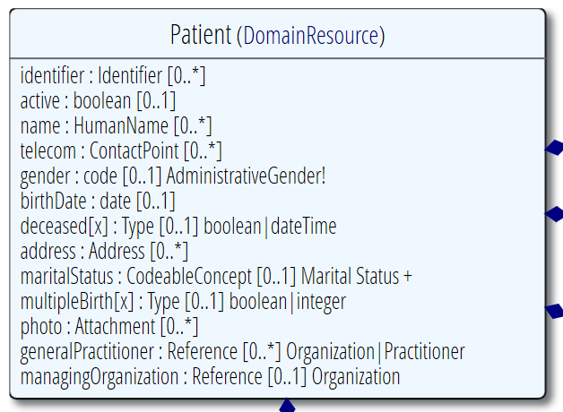
Profiling a resource
Demand that the identifier uses your national patient identifier
Limit names to just 1 (instead of 0..*)
Limit maritalStatus to another set of codes that extends the one from HL7 international
Add an extension to support “RaceCode”
Note: hardly any mandatory elements in the core spec!

Slide 31
Uses for profiles
Server & client may publish and check their conformance to a profile
Validating instances, messages
Implement "FHIR spec-like" website from Profiles as part of an Implementation Guide

Slide 32
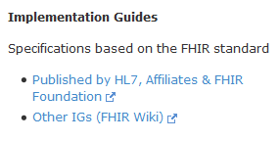
Examples…
Let’s look at US Core Profiles
http://hl7.org/fhir/
Implementation Guides
http://www.fhir.org/guides/registry
Simplifier
https://simplifier.net/guides
Notes:
Visit http://hl7.org/implement/standards/fhir/daf/daf.html
http://hl7.org/fhir => Implementation Guides => DAF
Example: DAF Patient - http://hl7.org/implement/standards/fhir/daf/daf-patient.html

Slide 33

Referring to a profile
Observation
Cholesterol
6.3 mmol/L
High
(recommended 4.5)
http://acme.org/
http://acme.org/StructureDefinition/LDLCholesterol
Metadata “Lipid Profile” v1.0.0 Draft
urn:acme.org:lipid-profile:v1
Author: e.kramer@furore.com
I’m conforming to (meta.profile=)
http://acme.org/StructureDefinition/LDLCholesterol
Structure “cholesterol”
Notes:
* You can formalize these constraining statements into a Profile Structure called ‘cholesterol’
* An Observation instance may use a Tag to assess conformance to that structure
* Validators check the contents of the instance against these constraints.
DSTU-2: Resource.Meta.profile (uri)
http://hl7.org/implement/standards/fhir/2015May/resource.html#Meta

Slide 34
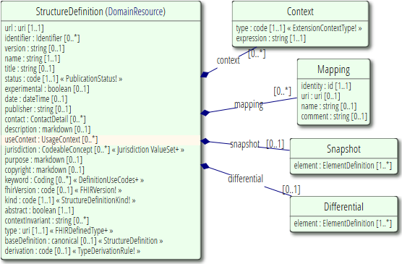
StructureDefinition
Defines datastructures
Core resources
Core datatypes
Constraints on resources & datatypes
i.e. “profiles”
Extensions
Logical Models

Slide 35
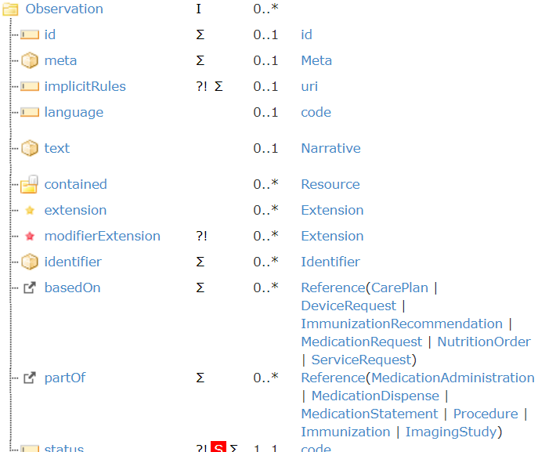
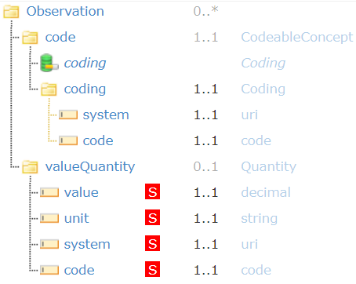
Differential vs. Snapshot

Slide 36
Differential vs. Snapshot
Differential
What’s changed from the base resource?
Added elements
Constrained elements
Only lists what’s different
Snapshot
What happens when you apply those differences to the snapshot of the parent model

Slide 37
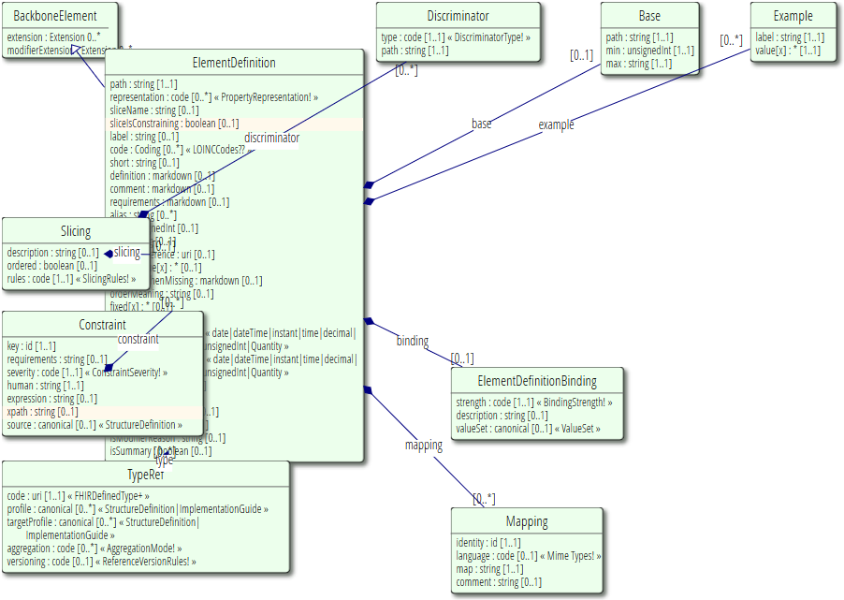
ElementDefinition
Describes every node in a data type, resource or logical model
Name, data type, cardinality, binding, definition, constraints, mappings, …

Slide 38
Must support?
Distinct from cardinality (what must be in instance)
Authors: SHALL be capable of providing a value for the element
Consumers: SHALL be capable of extracting and doing something useful with the element.
"Something useful" is context dependent. The profile or implementation guide SHALL describe what it means for applications to “support” the element
Notes:
Note: the spec *never* sets this to true, since it’s context dependent.
MustSupport is defined on element level
Cf. IsModifier: defined on structure level

Slide 39
Slicing
Schematic view of Composition (aka a Document header)
Composition
type: CodeableConcept
Section
code: CodeableConcept
content: Resource(Any) 0..1
0..*
Slicing = constraining a repeating element
Base Composition has 0..* “Sections”
Section has 0..1 element with content

Slide 40
Slicing into a CCD
Composition
type = “34133-9” “Summarization of
episode note”
Section
code = 42348-3 (“Advance directives”)
Section
code =11450-4 (“Problem list”)
…
Section
code = 18776-5 (“Treatment plan”)
“Slice” the repeating sections into a fixed set of profiled sections.
“code” is fixed and is called the discriminator

Slide 41
Aggregation
Aggregation: for each ResourceReference choose 1..3:
Code | Definition
contained | Reference to a contained resource.
referenced | Reference to a resource that has to be resolved externally
..bundled | Reference points to a resource found in the same bundle

Slide 42
Profiling “wisely”
Don’t constrain out elements unless they’re a genuine error
Patient can only have one name X
Patient can’t be deceased ✔
If you need to limit repetitions, instead slice and define what you want, possibly with extensions
Patient must have one name with use code of ‘legal’, jurisdiction of U.S. (extension?), and no end date
Patient must have one phone number with “lab call-back” extension

Slide 43
Authoring a FHIR Profile
FSH (FHIR Shorthand)
http://hl7.org/fhir/uv/shorthand/
Forge: FHIR-specific profiling tool
https://simplifier.net/forge
Lantana Trifolia Workbench
https://trifolia.lantanagroup.com
MDHT: UML Based modelling tool
https://projects.eclipse.org/projects/modeling.mdht
Notes:
Excel: FHIR Spec\v1.01\fhir-spec\site\uslab\patient-uslab-review.xls
MDHT: https://projects.eclipse.org/proposals/model-driven-health-tools, https://projects.eclipse.org/projects/modeling.mdht
Forge: Create a new Observation profile

Slide 44
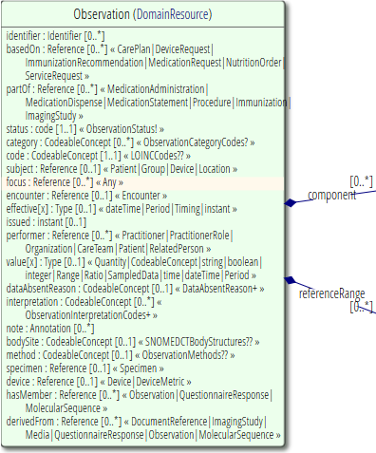
Observation resource

Slide 45
Let’s start constraining!
1..1
“if no value…”

Slide 46
Formal constraints
Notes:
Time start-10:00 (10 minutes)

Slide 47
Formal constraints
…beyond cardinalities and bindings, there are a lot of other conditions you might want to formulate:
“If a Cholesterol value result is not available, use the comments field”
“A patient’s birthdate must be on or before today’s date”
These may concern a single element or cover multiple elements.

Slide 48
Formal constraints
Uses free text (human) + FHIRPath (executable)
Constraints should be declared on lowest element in the hierarchy that is common to all nodes referenced by the constraint.
Identified by (local) ‘Key’, involved elements refer to that id
Specify severity (“error”, “warning”, “best practice”)

Slide 49
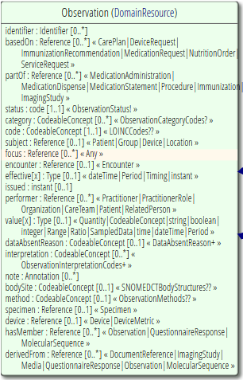
Context of the constraint
“If a Cholesterol value result is not available, use the note field”
This constraint is on the elements “valueQuantity” and “note”
We would have to formulate this constraint on the Observation, this is the context of the constraint
We assign the constraint a “key” value that’s unique within the Observations’ constraints
We refer from both “value[x]” and “comments” to this “key”. This means: if my value changes -> revalidate the constraint

Slide 50
Why FHIRPath
Need to enforce constraints in all syntaxes
XML, JSON, RDF, more?
XPath 1.0 is too limited, XPath 2.0 isn’t supported in a number of key languages
Wanted a path language that was terminology aware

Slide 51
FHIRPath vs. XPath
FhirPath
uniqueId.where(preferred = true).distinct(type)
Xpath
not(exists(for $type in distinct-values(f:uniqueId/f:type/@value) return if (count(f:uniqueId[f:type/@value=$type and f:preferred/@value=true()])&gt;1) then $type else ()))

Slide 52
FHIRPath applications
Invariants in ElementDefinition
Slicing discriminator
Search parameter paths
Error message locations in OperationOutcome
URL templates in Smart on FHIR's CDS hooks
PATCH

Slide 53
FHIRPath syntax
Syntax & formal grammar:
http://hl7.org/fhirpath/
https://github.com/ewoutkramer/fhirpath/blob/master/fluentpath.md
Resembles .NET LINQ / Java query expressions
Example:
Patient.identifier.where(use=‘official’)
Patient.**.extension(‘…url…’)

Slide 54
FhirPath tools
Nicolai http://niquola.github.io/fhirpath-demo/#/
Brian Postlethwaite https://github.com/brianpos/FhirPathTester
Notepad++ plugin by Grahame http://www.healthintersections.com.au/FhirServer/fhirnpp.htm
Simplifier connector

Slide 55
FhirPath libraries
Reference implementations
.NET
Java
Delphi
JavaScript

Slide 56
extensions
Notes:
Time start-10:00 (10 minutes)

Slide 57
Extensions
Accommodate those elements not supported by 80% of systems
Note - You’re not extending a resource per se, but you specify where an extension may occur:
A specific element within a resource (even root)
A specific element within a data type
All elements referencing a data type
All elements mapping to a specific mapping target
An extension

Slide 58
Extension Context
An extension has a context type
Resource, Datatype, Extension, Mapping
And a context path
(Resource) Observation
“The observation was calculated”
(Resource) Observation.value
“The observation’s ‘value’ was calculated”
(Datatype) Quantity
“This quantity was calculated” (any Quantity used in any resource!)

Slide 59
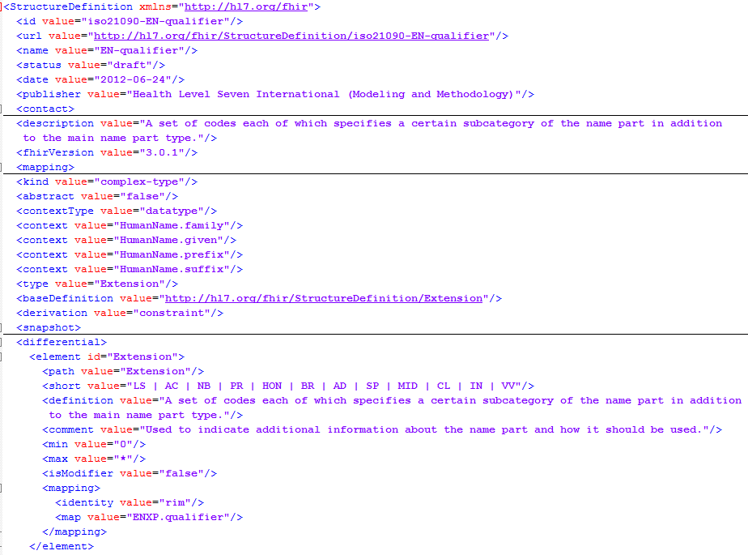
Extension Definition
Support multiple contexts!

Slide 60
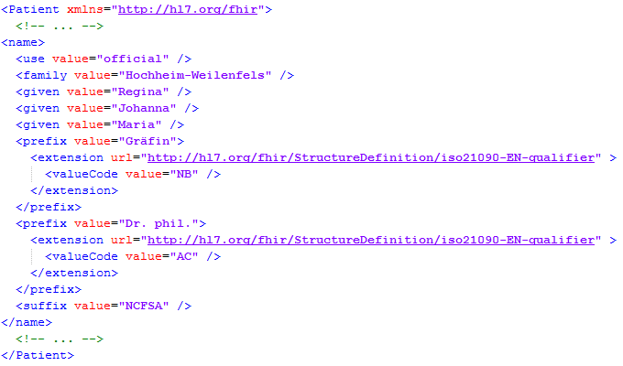
Extending a name
Key = location of formal definition
Value = value according to definition
Notes:
http://hl7.org/implement/standards/fhir/2015May/name-part-qualifier.html
NB = Nobility
AC = Academic

Slide 61
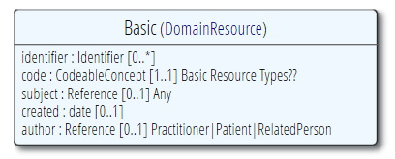
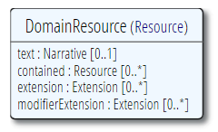
The “Basic” resource
Now, what if you have the need for a completely “new” resource?
…then add extensions for each element

Slide 62
Logical Models
Notes:
Time start-10:00 (10 minutes)

Slide 63
Logical Models
“Tree of data that has no particular use in the FHIR exchange paradigms.”
Typically used to represent ad-hoc combinations of FHIR data for packaging convenience
And/or content models as defined by other specifications (e.g. CDA, CIMI, openEHR).

Slide 64
Logical Models
Logical Models may use normal FHIR data types - or even resources
Have the full suite of the FHIR definitional framework to call on (e.g. terminology definitions/service, mapping language, etc).

Slide 65
Implementation guides
Notes:
Time start-10:00 (10 minutes)

Slide 66
Different Kinds
Strategy
National scope guide
Principles
Overarching principles
Subject
Subject with multiple usecases
Usecase
Single usecase
e.g. medication process
e.g. prescription
e.g. basic components
e.g. infrastructure, security

Slide 67
Typical Content
Title
Table of contents
Document information
Introduction to the guide
Principles & background
Functional requirements and high-level use cases
Design considerations
Package contents (= use case?)
Privacy and security guidance
Testing and certification
Appendix
List of all artifacts used in this guide
Notes:
Best practices, guidelines, default template
Recommended, not mandatory
Proposed template: http://implementationguidetemplate.azurewebsites.net/
Example: https://simplifier.net/ui/ig/SIG

Slide 68
Examples
http://hl7.org/fhir
External Links: > Implementation Guides
US Core
Structured Data Capture
International Patient Summary
…

Slide 69

Implementation Guide Resource
Define content structure
References to external artifacts
Page content files
Images, CSS, JavaScript
Supported page formats:
Markdown
HTML

Slide 70
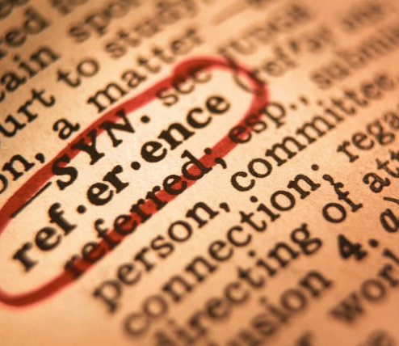
Implementation Guide Resource
Define conformance package(s)
Set of conceptually related artifacts
Based on FHIR NPM package
Specify references to external artifacts
StructureDefinition
OperationDefinition
SearchParameter
ValueSet
Example resources

Slide 71
Implementation Guides & Package
Implementation Guide
Provides human-readable information (narrative)
Contains formatted text, pictures, attachments, …
Explains to developers how to implement a specific use case
Publish to local/online website or to PDF
Package
Provides machine-readable information (computable)
Contains conformance resources
Allows machines to validate, generate code, generate UI, …
Publish to FHIR Package server

Slide 72
Authoring Implementation Guides
IG Builder
Official HL7 open source command line tool
Can render IG resource as a website

Slide 73
Authoring Implementation Guides
Simplifier
Browse & find published IGs
Supports online IG authoring & publication
Embed rendered artifacts

Slide 74


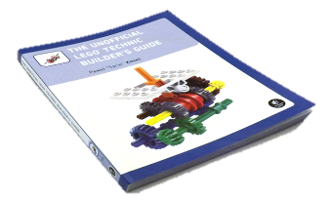


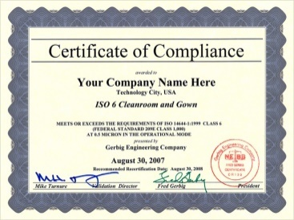

Publish!
Guide
Author & Store
Publish
http://simplifier.net
http://registry.fhir.org
Implement
Test & Verify
Notes:
Authoring workflow ⬄ Publishing workflow

Slide 75
Other Conformance Resources
Notes:
Time start-10:00 (10 minutes)

Slide 76
OperationDefinition
Describes additional operations over and above the RESTful interactions defined in the specification
RPC calls with FHIR
What is the name?
Input/output parameters
What does it do?
Works on which resources?
Notes:
Example: http://hl7.org/implement/standards/fhir/operation-valueset-validate-code.html
ValueSet validation

Slide 77
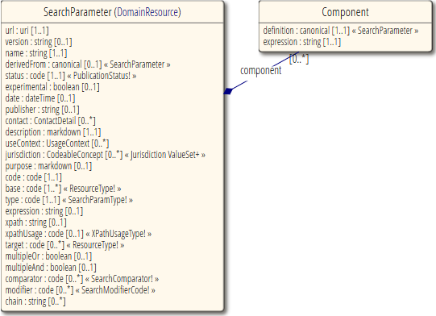
SearchParameter
Extend/restrict searches
Describes additional searches to filter resources
What is the name?
Elements filtered
Resource the search works on
Notes:
Note: better resource name would be “SearchParameterDefinition”
Example: HelseNord REKVIRENT extension

Slide 78
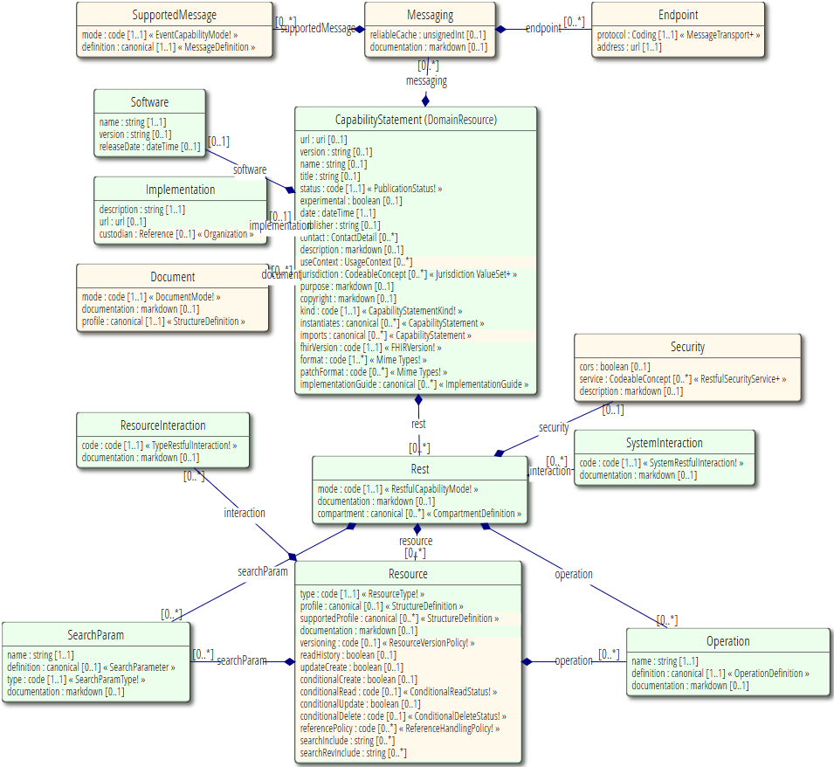
CapabilityStatement
A set of capabilities of a FHIR Server
Binds all conformance resources together
Large beast…
Notes:
Note: better resource name would be “SearchParameterDefinition”

Slide 79
CapabilityStatement
Describes how a client or server uses or should use the FHIR API
Which wire formats supported?
Which resources?
Which operations supported?
Which profiles supported?
Is this a test server?
What’s the name of the software?
Notes:
Note 1: API performs an (optional) version check on the first call
Note 2: Conformance resource for a fully fledged FHIR server can be quite large, e.g. 1.5MB

Slide 80
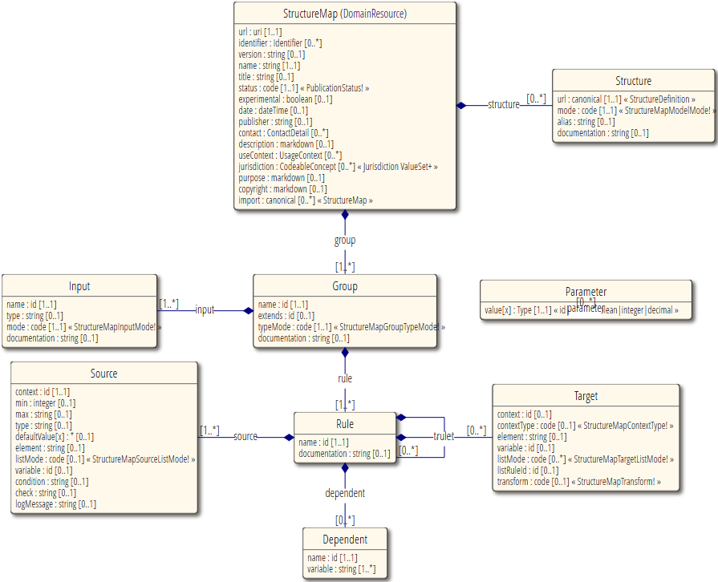
StructureMap
A map of relationships between 2 structures
Detailed set of rules that can be used to transform data
Notes:
Note: better resource name would be “SearchParameterDefinition”

Slide 81
FHIR Mapping Language
Addresses 2 very different kinds of transformations:
Structural changes between the source and target structures
Differences in formats in string (and related) primitives contained within the structures

Slide 82
Registries
Notes:
Time start-10:00 (10 minutes)

Slide 83
Official HL7 FHIR registries
HL7 FHIR Profile registry
https://registry.fhir.org/
Find official profiles published by HL7 intl. & WGs
HL7 FHIR Implementation Guide registry
http://www.fhir.org/guides/registry
Browse official HL7 implementation guides

Slide 84


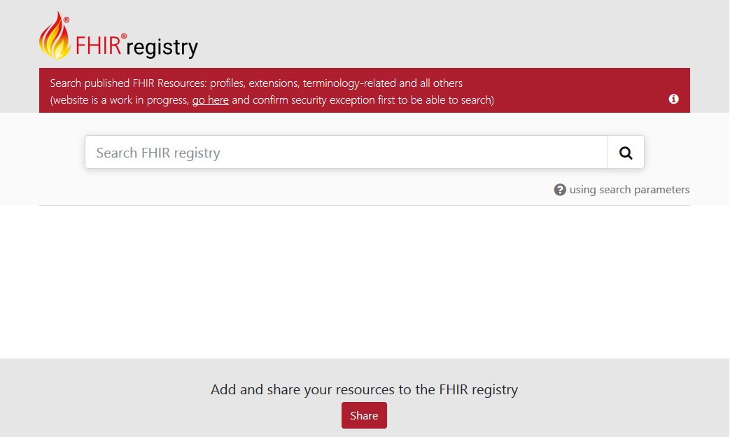

Registry.fhir.org
Powered by

Slide 85
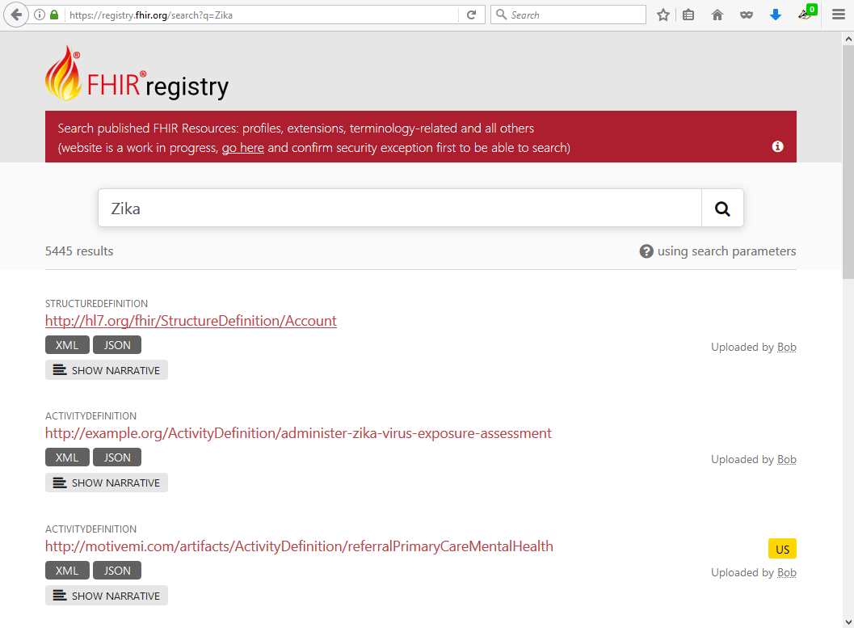
Registry.fhir.org

Slide 86
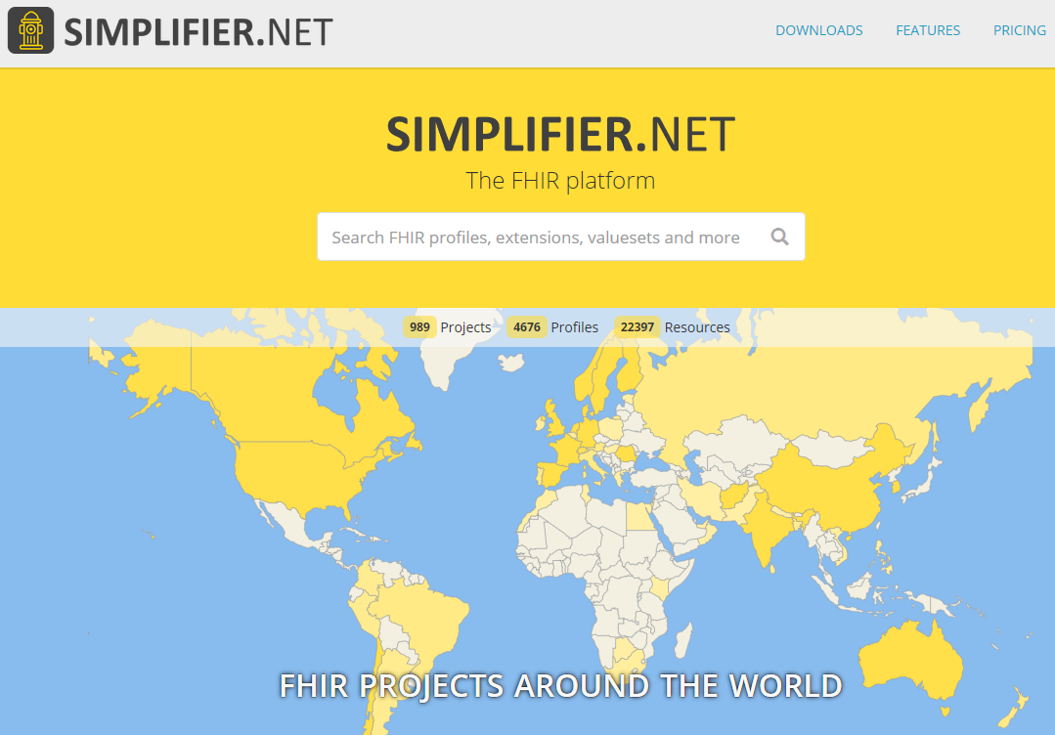
Public FHIR registry
Search, browse & find FHIR conformance resources:
Profiles, IGs, Valuesets, Examples, …
Contains:
Official HL7 profiles
HL7 affiliate profiles
Private company profiles
Public user profiles
https://simplifier.net
Notes:
Demo!

Slide 87

www.fhirdevdays.com

